Slide 1
Source Control Management, GIT

Slide 2

Agenda
Source Control Management (SCM)
Fundamental Terms
Types of Version Control Systems
Git
Before start
Configuration
Basics
Work cycle
Branches | Merging
Practical tasks
HomeWork

Slide 3
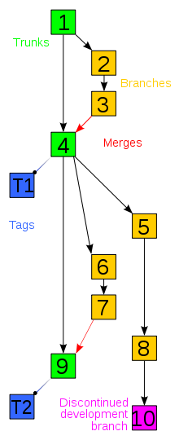
SCM
Revision control, also known as version control and source control (and an aspect of software configuration management), is the management of changes to documents, computer programs, large web sites, and other collections of information.
Notes:
A version control system serves the following purposes, among others.
Version control enables multiple people to simultaneously work on a single project. Each person edits his or her own copy of the files and chooses when to share those changes with the rest of the team. Thus, temporary or partial edits by one person do not interfere with another person's work. Version control also enables one person you to use multiple computers to work on a project, so it is valuable even if you are working by yourself.
Version control integrates work done simultaneously by different team members. In most cases, edits to different files or even the same file can be combined without losing any work. In rare cases, when two people make conflicting edits to the same line of a file, then the version control system requests human assistance in deciding what to do.
Version control gives access to historical versions of your project. This is insurance against computer crashes or data lossage. If you make a mistake, you can roll back to a previous version. You can reproduce and understand a bug report on a past version of your software. You can also undo specific edits without losing all the work that was done in the meanwhile. For any part of a file, you can determine when, why, and by whom it was ever edited.

Slide 4
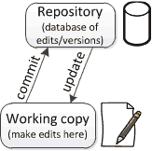
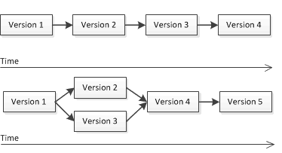
Fundamental Terms
Repository
Working Copy
Revision
Branching
Merging
Notes:
Master/main
Hero
Template – V2
Grass
Trees
Cars→ V5→ V6
Desi→V5, Train
Kiril→ V5, animals
Kalin→ Cars
Version control uses a repository (a database of changes) and a working copy where you do your work.
Your working copy (sometimes called a checkout) is your personal copy of all the files in the project. You make arbitrary edits to this copy, without affecting your teammates. When you are happy with your edits, you commit your changes to a repository.
A repository is a database of all the edits to, and/or historical versions (snapshots) of, your project. It is possible for the repository to contain edits that have not yet been applied to your working copy. You can update your working copy to incorporate any new edits or versions that have been added to the repository since the last time you updated. See the diagram at the right.
In the simplest case, the database contains a linear history: each change is made after the previous one. Another possibility is that different users made edits simultaneously (this is sometimes called “branching”). In that case, the version history splits and then merges again.

Slide 5
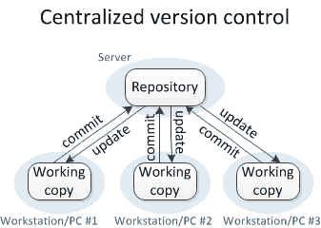
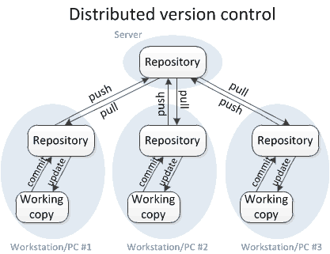
Type of SCM
Centralized: CVS, Perforce, SVN, Team Foundation Server (TFS)
Distributed: Git, Mercurial
Notes:
Centralized VCS – These systems, such as CVS, Subversion, and Perforce, have a single server that contains all the versioned files, and a number of clients that check out files from that central place. For many years, this has been the standard for version control. In centralized version control, each user gets his or her own working copy, but there is just one central repository. As soon as you commit, it is possible for your co-workers to update and to see your changes. For others to see your changes, 2 things must happen:
You commit
They update
Distributed VCS –
In distributed version control, each user gets his or her own repository and working copy. After you commit, others have no access to your changes until you push your changes to the central repository. When you update, you do not get others' changes unless you have first pulled those changes into your repository. For others to see your changes, 4 things must happen:
You commit
You push
They pull
They update
Notice!!! that the commit and update commands only move changes between the working copy and the local repository, without affecting any other repository. By contrast, the push and pull commands move changes between the local repository and the central repository, without affecting your working copy.

Slide 6
GIT Intro
Git – is a distributed revision control system with an emphasis on speed, data integrity, and support for distributed, non-linear workflows.
Git was initially designed and developed by Linus Torvalds for Linux kernel development in 2005, and has since become the most widely adopted version control system for software development.
Every Git working directory is a full-fledged repository with complete history and full revision tracking capabilities, not dependent on network access or a central server.

Slide 7


Before start
Firstly we need to check if we have a git client software.
Download and install git
Linux OS
Debian Family (Debian, Ubuntu, Mint) #apt-get install git
Red Hat Family (RHEL, CentOS, Fedora) #yum install git
MS Windows OS https://git-scm.com/download/win
Notes:
How to check if get is present?
In Linux OS:
Run terminal
Type git --version
If the result is something like that: git version 1.7.10.4 (the number of version should be another)
In MS Windows OS
Find Git Bash program in Program Menu
Run it and type in terminal git –version
Open SSL

Slide 8

If we need to know sth ☺
Help yourself
$git help <command>
$git <command> --help
$man git-<command>
Notes:
Github= git+repo
Bitbucket= git+repo

Slide 9
Let’s configure git ☺
Git comes with tool called git config
Identity
git config --global user.name “Vasia Pupkin“
git config --global user.email vpupkin@mail.com
Editor
git config --global core.editor emacs
Check settings
git config --global --list
Notes:
Git comes with a tool called git config that lets you get and set configuration variables that control all aspects of how Git looks and operates. These variables can be stored in three different places:
/etc/gitconfig file: Contains values for every user on the system and all their repositories. If you pass the option --system to git config, it reads and writes from this file specifically.
~/.gitconfig or ~/.config/git/config file: Specific to your user. You can make Git read and write to this file specifically by passing the --global option.
config file in the Git directory (that is, .git/config) of whatever repository you’re currently using: Specific to that single repository.
Each level overrides values in the previous level, so values in .git/config trump those in /etc/gitconfig.
Again, you need to do this only once if you pass the --global option, because then Git will always use that information for anything you do on that system. If you want to override this with a different name or e-mail address for specific projects, you can run the command without the --global option when you’re in that project.
Default text editor that will be used when Git needs you to type in a message. If not configured, Git uses your system’s default editor, which is generally Vim.

Slide 10
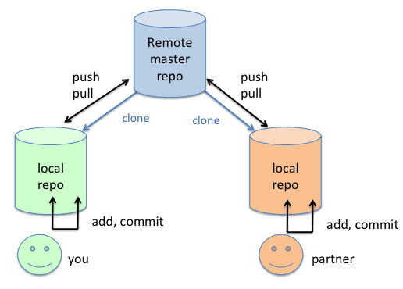
Create repository
git init – create an empty local repo
git clone <URL> – create local repo from remote repo
Notes:
Mkdir SoftServe
Cd SoftServe
Windows Explorer

Slide 11
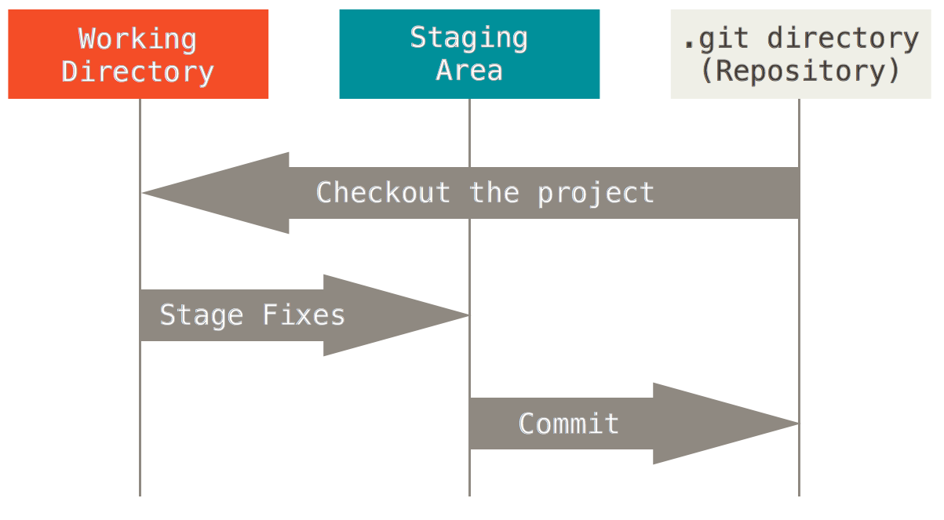
GIT basics
Git store snapshots of file system not differences!!!
Almost every operation is local
Notes:
Git has three main states that your files can reside in: committed, modified, and staged.
Committed means that the data is safely stored in your local database.
Modified means that you have changed the file but have not committed it to your database yet.
Staged means that you have marked a modified file in its current version to go into your next commit snapshot.
The Git directory is where Git stores the metadata and object database for your project. This is the most important part of Git, and it is what is copied when you clone a repository from another computer.
The working directory is a single checkout of one version of the project. These files are pulled out of the compressed database in the Git directory and placed on disk for you to use or modify.
The staging area is a file, generally contained in your Git directory, that stores information about what will go into your next commit. It’s sometimes referred to as the “index”, but it’s also common to refer to it as the staging area.
The basic Git workflow goes something like this:
You modify files in your working directory.
You stage the files, adding snapshots of them to your staging area.
You do a commit, which takes the files as they are in the staging area and stores that snapshot permanently to your Git directory.

Slide 12
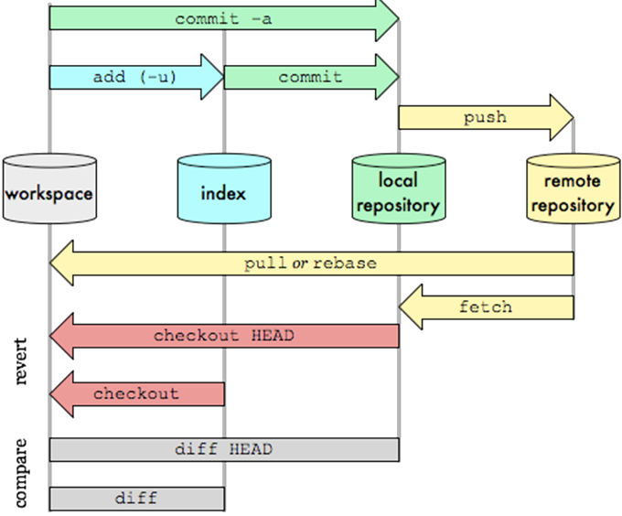
Git data transport commands

Slide 13

Must know commands!
git status – Show the working tree status
git add – Adds files to index
git commit – Commits staged files
git log – Show commit logs
git push – Send changes to remote repository
git pull – Fetch and merge changes on the remote server
Notes:
GitHub→Account
Repo→GitHub
Readme.md→ No
Git add Webui.txt
git commit –m “fix: Login form”
Cd\
C:\
Mkdir SoftServe
Cd SoftServe
Git init
Git add MyFirstFile.js
Git commit
………..

Slide 14

Branch
A branch represents an independent line of development. Branches serve as an abstraction for the edit/stage/commit process
Commands
git branch – list of branches in local repo
git branch <name> – create new local branch named “name”
git branch –d <name> – delete the branch named “name”
git branch –m <name> – rename the current branch to “name”
Notes:
Git branch payment
Git branch loginFix
Cd Name
Git checkout NameBranch

Slide 15
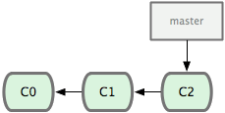
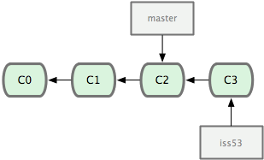
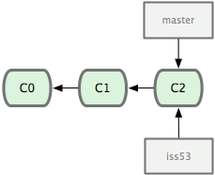
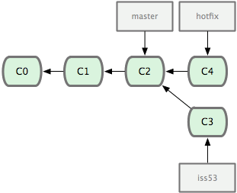
Let’s imagine
1
Three commits on master
3
git commit …
2
4
git checkout master
git checkout –b hotfix
git commit …
git checkout –b iss53

Slide 16
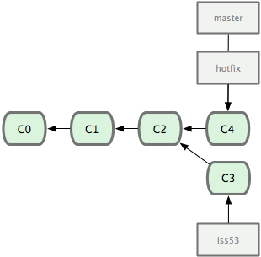
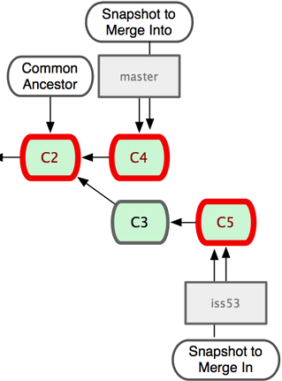
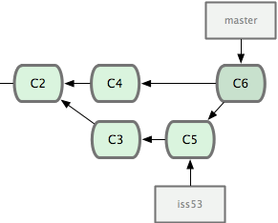
Merging
5
6
git checkout master
git merge hotfix
7
git merge iss53

Slide 17
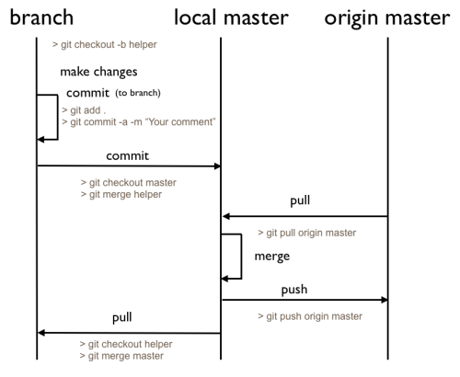
Team player / issue / bug fix philosophy

Slide 18
Command syntax | Description
git init | initializes a new repository
git clone | create a working copy of a local repository
git add | stages files ( adds to index )
git status | shows status of current branch
git commit | commits staged files
git branch | shows current branches
git branch [branch] | creates new topic branch
git checkout [branch] | switches HEAD to specified branch
git merge [branch] | merges [branch] with current branch
git diff | shows diff of unstaged changes
git log | shows history on current branch
git push | send changes to remote repository
git pull | fetch and merge changes on the remote server

Slide 19
References and Sources
https://github.com/ - link to Git repository
https://git-scm.com/book/en/v2 - original documentation from Git team

Slide 20
The end

